Slide 1
Software Architecture Evolution: Erosion & Smells
Damian A. Tamburri, Ph.D.

Slide 2
Architectural Erosion and Debt
Architecture Erosion ‘worsening over time’
What are the root causes that tend to erode the architecture?
Practice: If we know the root causes, we may try to avoid or mitigate them...
Technical Debt ‘quick-fix now, clean up later’
What is it?
What are the types of debt?
Can we measure it?
Practice: If we know root causes, we may try to avoid or mitigate them...

Slide 3
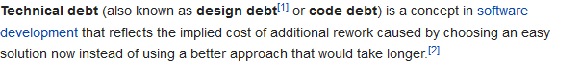
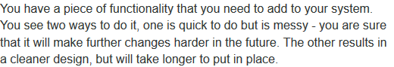
Erosion/Debt?
Two concepts – what is the difference?
CSMR2012
Wikipedia
Fowler, 2003

Slide 4
My Perspective
Erosion / Decay
All the processes that ‘widens the gap’ between as-designed and the as-implemented software architecture
(If you never designed one, there is not erosion, by definition ☺)
Debt
The actual code changes that are not aligned with the as-designed architecture
Refactoring/clean up processes can ‘lessen the gap’ / ‘re-align as-implemented with as-designed’

Slide 5
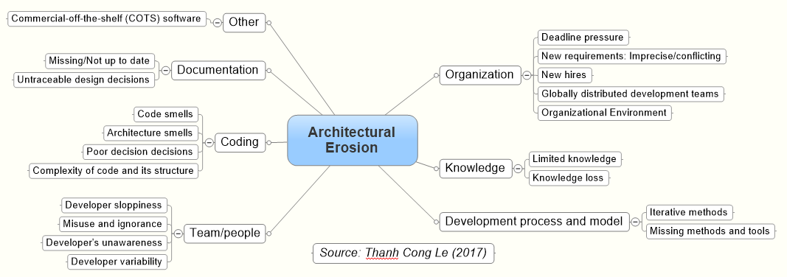
Or... Graphically
Debt

Slide 6
Agenda
Architecture Erosion [Le, 2017]
Definitions and root causes
Technical Debt
Definitions and Types [McConnel, Krutchen et al.]
Measurement [Kazman et al.]
And a seemingly result in important root causes

Slide 7
Terms and Definitions*
Le has made an impressive literature study to answer the following research questions:
The english in the report is sometimes a bit denglish: ‘Carl means that…’
* Le’s Master Thesis contains the full work.

Slide 8
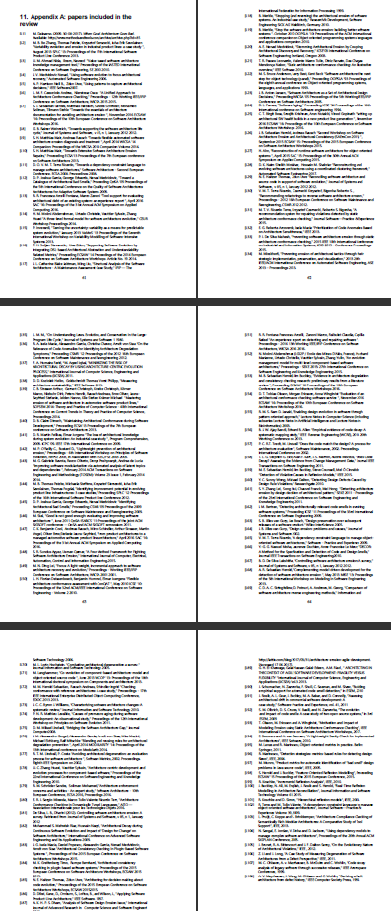
Literature Study
Systematic literature study
Initial search
Include references in primary papers
New terms for ‘architecture erosion’ included
Extra 12 papers
Total: 108 full papers.

Slide 9
Definition
Synonyms
Architecture erosion
Architectural decay
Software erosion
Design erosion
Design decay

Slide 10
Visualization
Note:
It is not a documentation issue...
A as-designed architecture may not be documented in written form, but still exist.
”Ask the architect”

Slide 11
Root Causes
[Le, 2017]
Note: Not orthogonal aspects...

Slide 12
Architectural Erosion
Organization Aspects

Slide 13
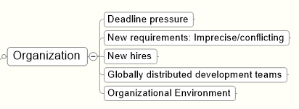
Deadline
Focus on deadline instead of design for change
Cunningham: ”not quite right code which we postpone making it right”
New requirements: hard/imprecise/conflicting
Code that do things not designed to do
New employees
New people, unaware of architecture details, code based upon perception/assumptions instead of knowledge

Slide 14
Deadline
Global teams
Again, code on assumptions more than knowledge
‘Us’ versus ‘them’ / problematic knowledge transfer
Cultural misunderstandings
Problematic communication lines, too little communication
Organization environment
Low morale, high turnover, blaming culture, cover-my-ass, don’t-care, ...

Slide 15
Architectural Erosion
Knowledge Aspects

Slide 16
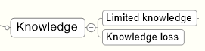
Limited knowledge
Again, refactorings/maintenance based upon limited/incorrect/assumed knowledge of architecture, of course leads to erosion
Knowledge loss
Stroustrup: the best way to transfer knowledge from architect to developer, is that it is the same head
Every designer/architect that leaves, takes a lot of knowledge away from the project/product
Knowledge vaporization
”Failure to record decisions”

Slide 17
Architectural Erosion
Development Process Aspects

Slide 18
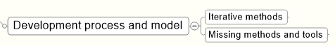
Iterative methods
”working software valued more than comprehensive documentation”
Taken to the extreme, architecture information becomes very volatile, and easily ‘vaporize’.
Missing methods and tools
Lack of tools to monitor architectural conformance is problematic.
Open research question to create some that does just that…

Slide 19
Architectural Erosion
Team and Culture Aspects

Slide 20
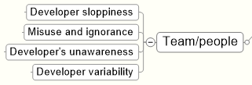
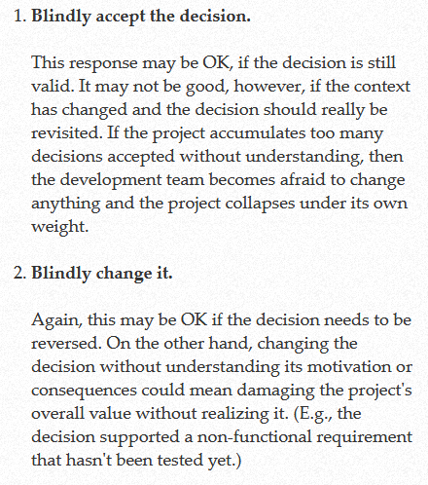
Developer sloppiness
Laziness, not documenting/not following architecture
Misuse and ignorance
Misunderstanding as-designed of course leads to erosion of as-implemented
Compare Nygard ADT
‘Less capable’ programmers turn out less quality code

Slide 21
Developers’ unawareness
Aware of basic concepts, but unaware of how to integrate in current context
”Knowledge and skills”
Knowledge: Have the theory of Strategy pattern, have read the book
Skills: Can actually find the code bit that benefit from Strategy, and correctly can introduce it
Developer variability
Highly capable programmers turn out code that less capable programmers have a hard time to understand and modify
Bass: ”Buildability” quality attribute...

Slide 22
Architectural Erosion
Coding Aspects

Slide 23
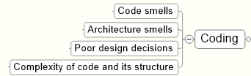
Code smells
Blob, God class, duplicate code, spaghetti code, long parameter lists, Clean code breaking…
Architecture smells
ISO Maintainability
Analyzability
Changeability
Stability
Testability

Slide 24
Poor design decisions
Design decisions are hierarchical
Bad design at upper level have many consequences at lower/dependent levels => chain reaction of revisions...
Lack of review/debate/criticism leads to bad high level decisions
Complexity of code and structure
(Needless) Complexity => low analyzability
int a[1817];main(z,p,q,r){for(p=80;q+p-80;p-=2*a[p])for(z=9;z--;)q=3&(r=time(0) +r*57)/7,q=q?q-1?q-2?1-p%79?-1:0:p%79-77?1:0:p<1659?79:0:p>158?-79:0,q?!a[p+q*2 ]?a[p+=a[p+=q]=q]=q:0:0;for(;q++-1817;)printf(q%79?"%c":"%c\n"," #"[!a[q-1]]);

Slide 25
Architectural Erosion
Documentation Aspects

Slide 26
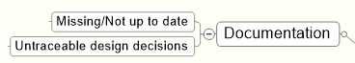
Missing/Not up to date
Inaccurate/missing documentation leads to false assumptions
Existing documentation may not even be consulted or difficult to find
SA@Work: Company X’s architect mentioned their architectural documentation, but, when asked, spent 15 minutes and involved two other architects in order to find it on the company file system ☺
Untraceable design decisions
Design decisions are not manifest in code.
Even if decision is documented, the context is not
Alas [Tyree and Akerman, 2005]’s ‘positions’ – why were alternatives rejected?

Slide 27
Architectural Erosion
Commercial Off The Shelf Aspects

Slide 28
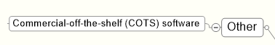
COTS
COTS makes your architecture fit the COTS product, not the other way round
COTS products that end their life but our system still relies on it

Slide 29
Not Orthogonal!

Slide 30
Detecting Erosion

Slide 31
Overview

Slide 32
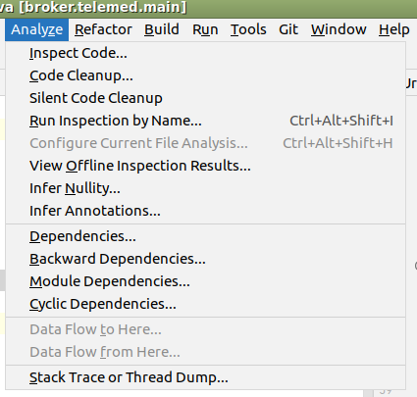
Manual Approach
Code inspection
Focus: God class, duplicate code, long parameter lists
Sidenote: IntelliJ has static analysis tools
Architectural artifacts inspection
Focus: module functionality, size, dependencies

Slide 33
Semi-automatic
Metric based
Detect code smells using code metrics
Hm... I have supervised quite a few projects and so far the conclusions always seems to be: metrics tell little about quality ☹
Ex: Low coupling is good! But what about coupling to ‘String’? Reuse X means more classes are coupled to X, right?
SQUALE model/Sonar

Slide 34
Historical Data Analysis
Change management data history
‘covariance’: unrelated source files are always changed in the same commits. Maybe they are related then?
Architecture History
(Sorry, did not get that…)
Defect-fix history
A variant of the ‘change mgt history’ I think…

Slide 35
Compliance checking
Boils down to
Express rules in some language
Typically constrain dependency rules
Make tool that match rules with code base to spot deviances
Actually, [Christensen & Hansen, 2011], proposed

Slide 36
Avoiding Architectural Erosion

Slide 37
So, What to Do?
First step: Increase architectural erosion awareness within the organization

Slide 38
Organization
Awareness

Slide 39
Knowledge
Knowledge management
Personalization strategy
Interaction and communication among developers
Architectural knowledge management
Identifying and storing knowledge in artifacts and repositories
Make knowledge explicit
Make conformance analyses continuously

Slide 40
[Sidebar]
[Christensen and al., APSEC 2009]

Slide 41
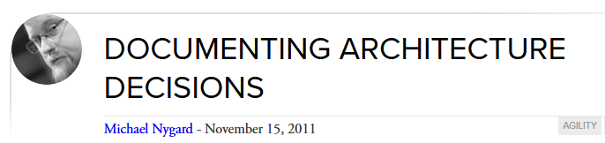
Development Process
Architecture decision enforcement
Ensure that architectural decisions are kept enforced during implementation
Tool support suggested by some authors
Architecture evolution management
Manage changes in implementation and architecture in parallel
Yes, but does sound heavy ☹
Maintenance Process…
Lightweight approach…

Slide 42
Development Process
Architecture evaluation (continuously)
ATAM from the Bass’ book (akin of our QAW)
[Christensen, Madsen, Lindstrøm, ECSA 2010]
aSQA technique developed by Systematic
Compliance monitoring
Monitoring defect metrics
As increased defect rate and average fix time are indicators of architectural erosion
Scaled Agile Framework
(Sorry, did not get that...)
ArchUnit?

Slide 43
Team and People
Personal Development
Share understanding of system’s architecture
Education
(Ensure people follow the AU ‘SAiP’ course ☺)
Awareness
Again, again...

Slide 44
Coding
Design Enforcement
Architectural patterns: Know thy patterns...
Architectural anti-patterns: Know thy anti-patterns
Frameworks: Use them
Review: Review code systematically
Code generation
A really old dream: Draw architecture ➔ Code ...
Refactoring
Clean up the mess...
Automatic test
Supports refactoring

Slide 45
Documentation
Well-documented architecture is essential for preventing architectural erosion
The high cost often is an inhibitor, though...
Design rationale/decisions stressed by authors...

Slide 46
Phew...
Lots of authors and research. Lots of perspectives and views...
Many are general observations
Some are highly specific, and less relevant in given context
Like ‘scaled agile framework’
But – I find there are some root causes across the line!

Slide 47
Communication!
Well-communicated architecture (decisions!) essential
And communication means talking in a respectful environment
Knowledge transfer so architecture survives staff churn

Slide 48
Organizational Context
Stable, friendly, good working environments

Slide 49
Knowledge and Skills
Have well trained architects and developers

Slide 50
Decisions!
Interesting to note just how many times the design rationale and decisions pops up in the papers!
Architectural views can be inferred from the code
Module: easy, CC: hard but doable, Deploy: easy(?)
Rationale cannot!!!
We only glimpse the decisions made, never those rejected!

Slide 51
Some E2020 Points
The participants in the E2020 added a few points to the list of architectural erosion root causes
Architecture by Management
Dictated decisions by business people
Which may not really be good decisions
Evolution of context at large
External dependended-on units that reach end-of-life
Security that is tightened
Execution environment changes (OS updates etc.)

Slide 52
Summary
A lot of aspects conspire to erode your architecture...
Awareness is probably the most important aspect...

Slide 53
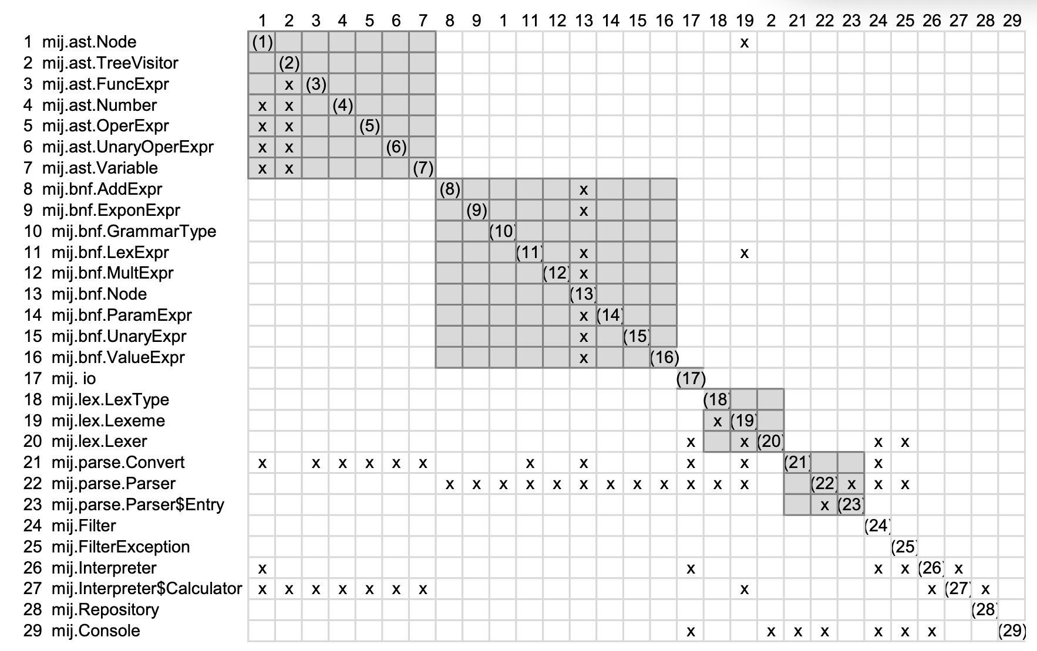
Detecting Erosion Automatically!* ➔ Arch. Smells!
*”Design Rule Spaces: A New Form of Architecture Insight” Xiao et al.

Slide 54
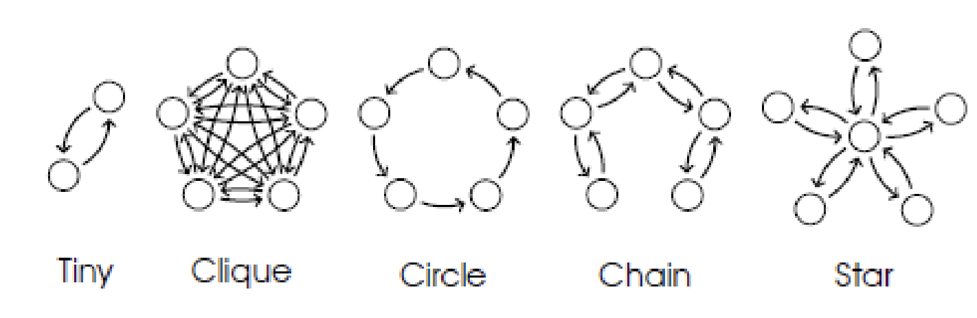
Resulting Architecture Smells: Basic Shapes

Slide 55
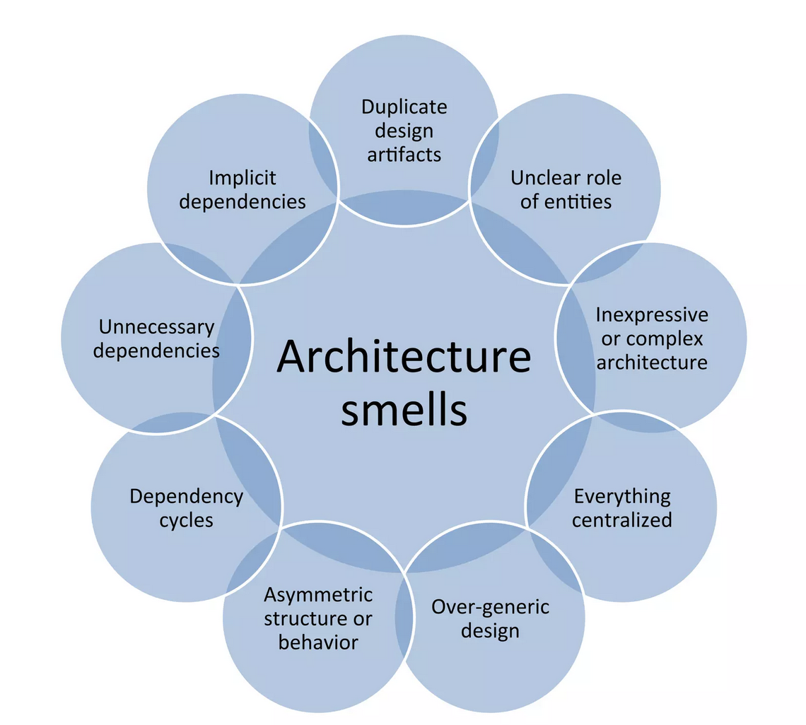
Resulting Architecture Smells: Smells Explained

Slide 56
Resulting Architecture Smells: Smells from MSDN*
Impossible Component Swap: this smell reflects architecture components which are too tightly connected to the rest of the architecture which may lead to substitution problems.
Untraceable Business Requirement: this smell reflects overly fine-grained architectures where it becomes difficult to trace high-level business requirements across the entire architecture. This hinders the ability to analyze the quality aspects behind that requirement and consequently the overall quality of the architecture.
Sloppy Modularisation: this smell reflects carelessly modularised architectures, e.g., architectures that decrease cohesion for no good reason. This negatively impacts the architecture's evolvability and lessens a project manager's ability to divide work cleanly among programmers.
Unscalable Architecting: this smell reflects an architecture that can barely perform its functions in the face of rapidly increasing service demands; such architectures are not built with scalability in mind and so they are typically difficult, costly, and risky to modify.
*microsoft Sw. Development Network ➔ Tamburri et al.
Notes:
https://ieeexplore.ieee.org/stamp/stamp.jsp?arnumber=9712241

Slide 57


Slide 58
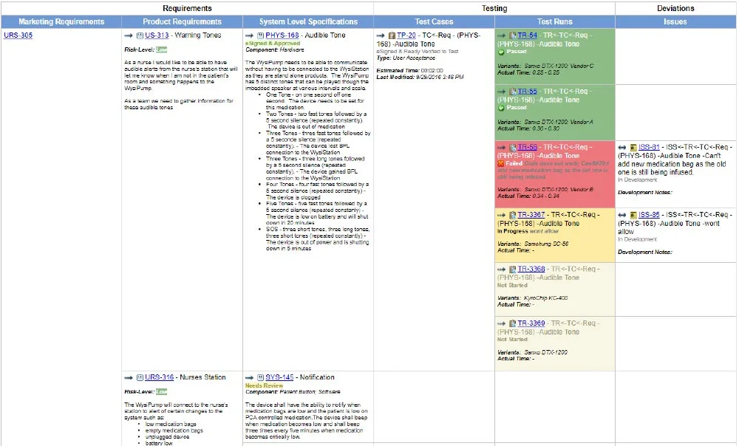

Slide 59
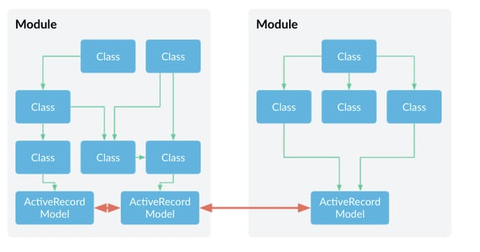

Slide 60
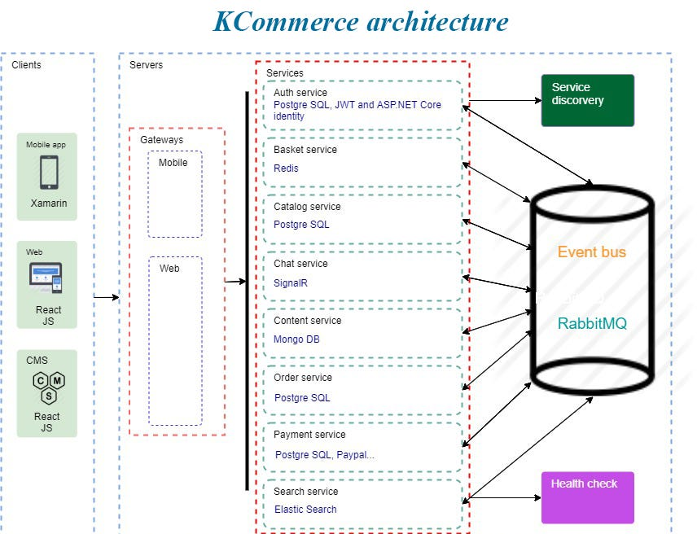

Slide 61
Resulting Architecture Smells: Smells from MSDN*
Inflexible Architecture / God Modules: this smell reflects architectures where a small number of components or modules contain significant functionality, creating bottlenecks for maintainability.
Unmodifiable Core: this smell reflects architectures that have gradually grown out of a core which is more and more becoming functionally untouchable and incomprehensible. This is often a consequence of Sloppy Modularisation.
Spike-Centric Architecture: this smell reflects architectures that emerged from architecture spikes, i.e., ``[...] architectural spike is a test implementation of a small part of the application's overall design or architecture". Relying heavily on architecture spikes may cause severe integration and evolution issues.
*microsoft Sw. Development Network ➔ Tamburri et al.
Notes:
https://ieeexplore.ieee.org/stamp/stamp.jsp?arnumber=9712241

Slide 62
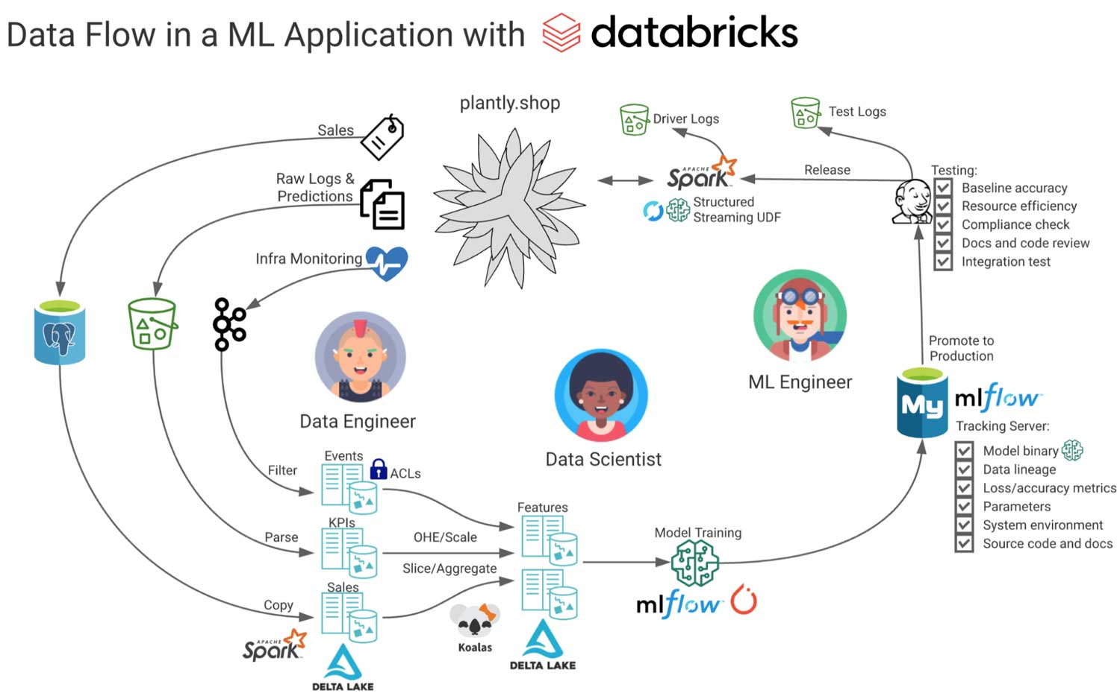

Slide 63
Resulting Architecture Smells: Smells from MSDN*
Quality-Implicit Architecture: this smell reflects architectures for which quality analysis of one (or more) software architecture properties (e.g., performance, reliability, safety) is so complex that it is never actually done.
Architecture Monolith: this smell reflects architectures whose design has grown into a fully connected mesh and therefore cannot be evolved other than by incurring heavy refactoring costs. Such monoliths may have originated as God modules.
Insensitive Information Spreading: this smell reflects architectures in which one or more components carelessly disseminate the data that the software architecture is manipulating. This can cause security vulnerabilities as well as privacy-policy violations.
*microsoft Sw. Development Network ➔ Tamburri et al.
Notes:
https://ieeexplore.ieee.org/stamp/stamp.jsp?arnumber=9712241

Slide 64
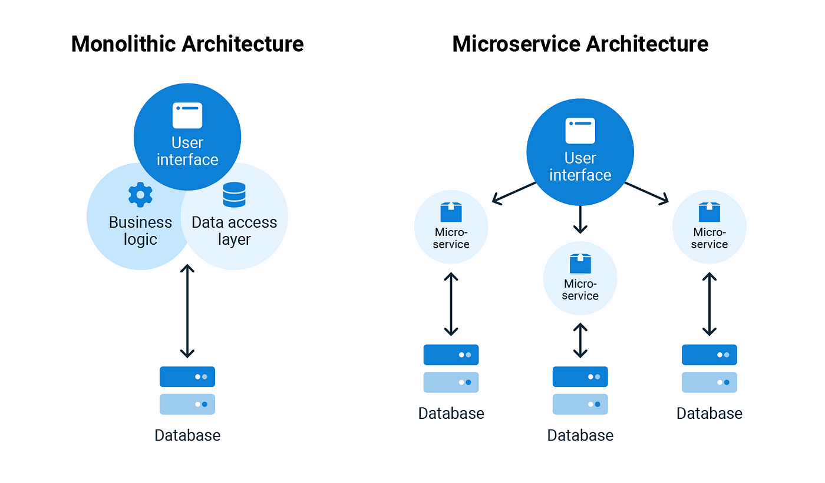

Slide 65
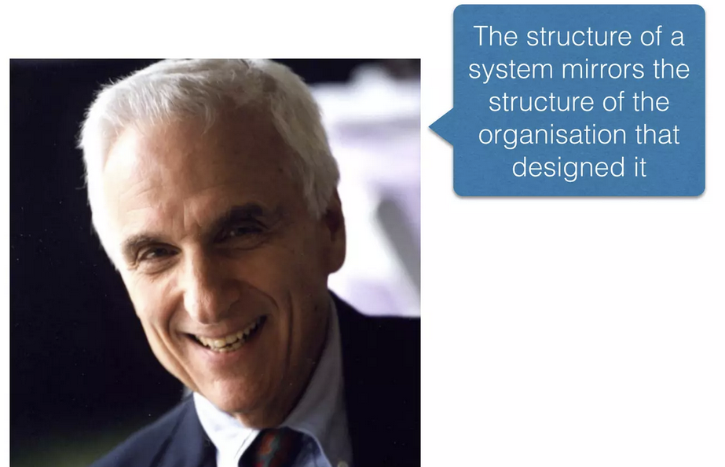
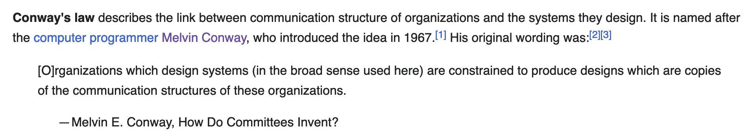
Conway’s Law

Slide 66
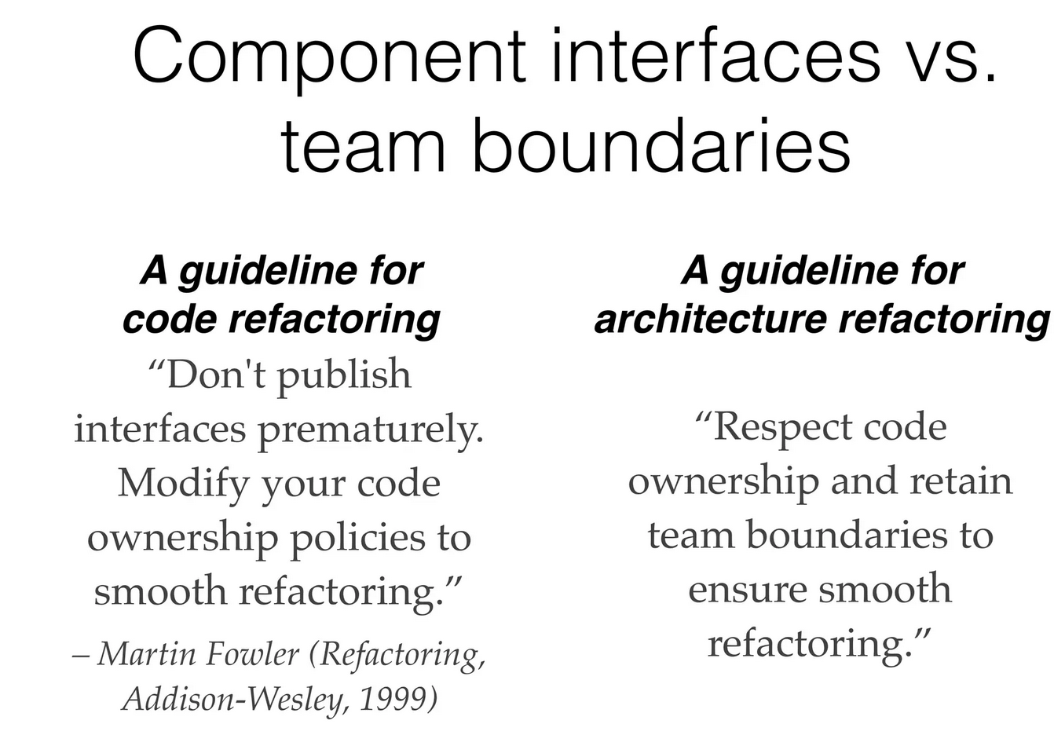

Slide 67

Questions?

